Slide 1

Customer Shopping Behavior Analysis
This project analyzes customer shopping behavior using transactional data from 3,900 purchases. Our goal is to uncover insights into spending patterns, customer segments, product preferences, and subscription behavior to guide strategic business decisions.

Slide 2

Project Overview
Goal
Uncover insights into spending patterns, customer segments, product preferences, and subscription behavior.
Data Source
Transactional data from 3,900 purchases across various product categories.

Slide 3

Dataset Summary
3,900 Rows
Transactional data points.
18 Columns
Including demographics, purchase details, and shopping behavior.
Key Features
Age, Gender, Location, Item Purchased, Category, Purchase Amount, Subscription Status.
Missing Data
37 values in Review Rating column, handled during cleaning.

Slide 4

Exploratory Data Analysis
(Python)
We began with data preparation and cleaning using Python:
Data Loading & Initial Exploration
Missing Data Handling (median imputation)
Column Standardization (snake_case)
Feature Engineering (age_group, purchase_frequency_days)
Data Consistency Check (dropped promo_code_used)
Database Integration (PostgreSQL)

Slide 5
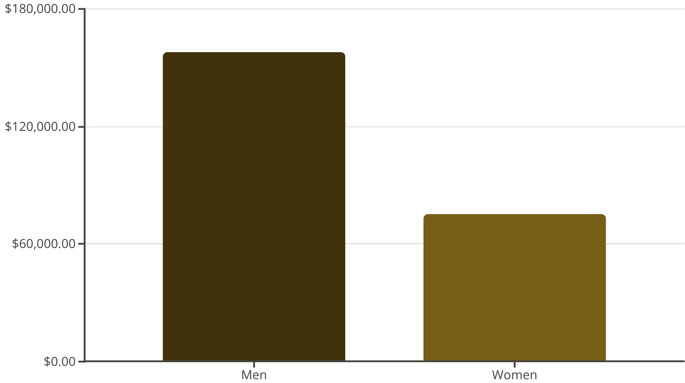
Key SQL Analysis: Revenue by Gender
SQL analysis revealed a significant difference in revenue generation between genders.
Men: $157,890
Women: $75,191
This insight can inform targeted marketing strategies.

Slide 6





Top 5 Products by Rating
Gloves
Sandals
Boots
140 reviews, 3.86 avg rating
160 reviews, 3.84 avg rating
144 reviews, 3.82 avg rating
Hat
Skirt
154 reviews, 3.80 avg rating
158 reviews, 3.78 avg rating

Slide 7


Shipping Type & Subscription Impact
Shipping Type Comparison
Subscribers vs. Non-Subscribers
Average purchase amount for Standard shipping: $58
Subscribed customers (1053) average spend: $59, total revenue: $62,645
Average purchase amount for Express shipping: $60
Non-subscribed customers (2847) average spend: $59, total revenue: $170,436

Slide 8
Discount-Dependent Products
50%
49.6%
49.2%
Hat
Sneakers
Sweater
77 discounted purchases out of 154
72 discounted purchases out of 145
79 discounted purchases out of 164
49.1%
47.4%
Coat
Pants
79 discounted purchases out of 161
81 discounted purchases out of 171

Slide 9


Customer Segmentation & Age Group Revenue
Customer Segments
Revenue by Age Group
Loyal: 3116 customers
Young Adult: $62,143
Returning: 701 customers
Middle-aged: $59,197
New: 83 customers
Adult: $55,978
Repeat buyers with >5 purchases are more likely to subscribe (958 Yes vs. 2518 No).
Senior: $55,763

Slide 10
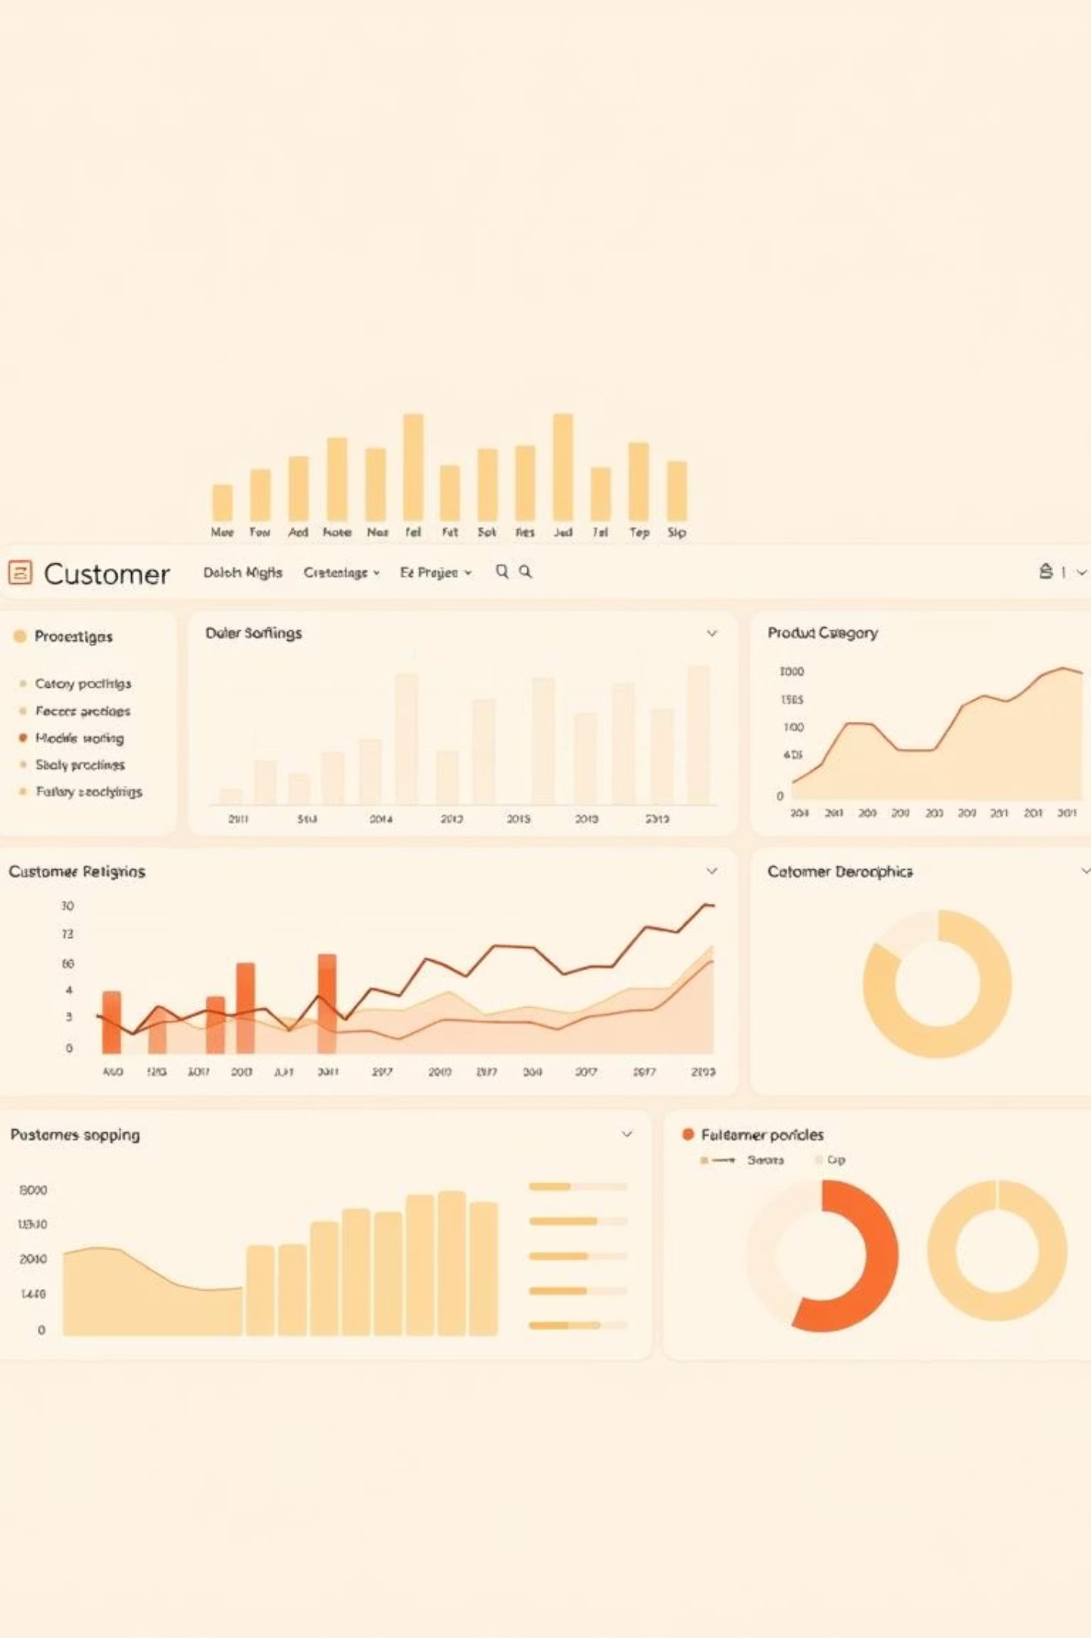
Power BI Dashboard Insights
Customer Base & Engagement
Revenue & Sales by Category
3.9K customers, 73% non-subscribed. Avg. purchase: $59.76, Avg. review: 3.75.
Clothing leads in revenue (>$100K) and sales volume, followed by Accessories, Footwear, and Outerwear.
Age Group Analysis
Young Adults generate highest revenue (approaching $60K), Seniors lowest despite similar customer counts.

Slide 11





Business Recommendations
Boost Subscriptions
Promote exclusive benefits to increase subscriber base.
Customer Loyalty Programs
Reward repeat buyers to foster loyalty and retention.
Review Discount Policy
Optimize discounts to balance sales boosts with margin control.
Targeted Marketing
Focus efforts on high-revenue age groups and express-shipping users.

